Slide 1
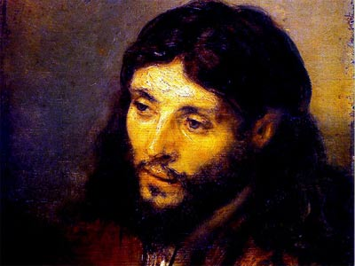
Who is Jesus Really? John 1:1-5
Rick Griffith • Crossroads International Church • BibleStudyDownloads.org

Slide 2
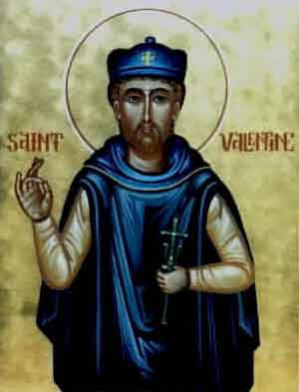
Happy…
Saint Valentine's Day
Year of the Tiger

Slide 3
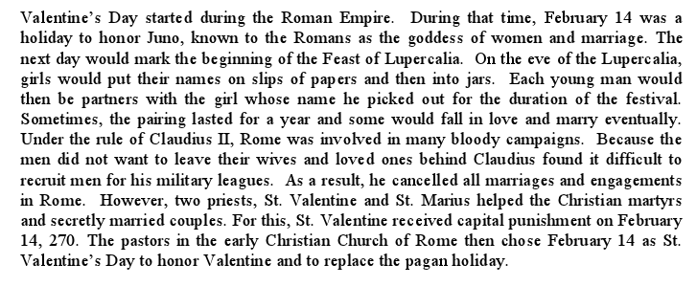
History of Valentine's Day

Slide 4
Plaza Singapura Lift

Slide 5
What a Meeting!

Slide 6
So who is Jesus?

Slide 7
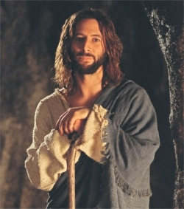
Why should we believe Jesus is God?

Slide 8
Key Word Believe
Keys to John
107
Key Verse
“Jesus did many other miraculous signs in the presence of his disciples, which are not recorded in this book. But these are written that you may believe that Jesus is the Christ, the Son of God, and that by believing you may have life in his name”
(John 20:30-31).

Slide 9
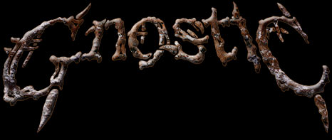
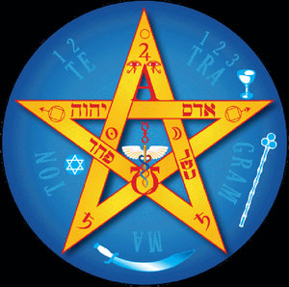
John's Context: Beginning Form of Gnosticism

Slide 10
Three reasons we should believe that Jesus is God…

Slide 11
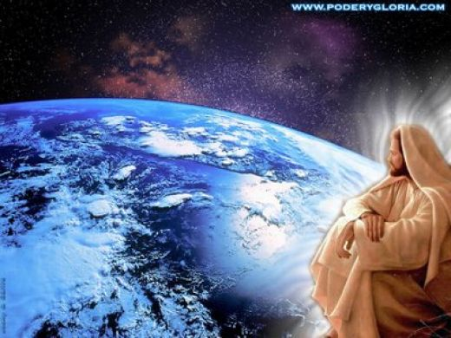
I. Jesus existed before creation as God (1:1-2).

Slide 12
Jesus (logos) had no beginning (1a)
“In the beginning
was the Word,
and the Word was with God,
and the Word was God”
(John 1:1 NIV)
Notes:
Scripture is very clear that Jesus is God. Christians have always believed this key doctrine called the deity of Christ.

Slide 13
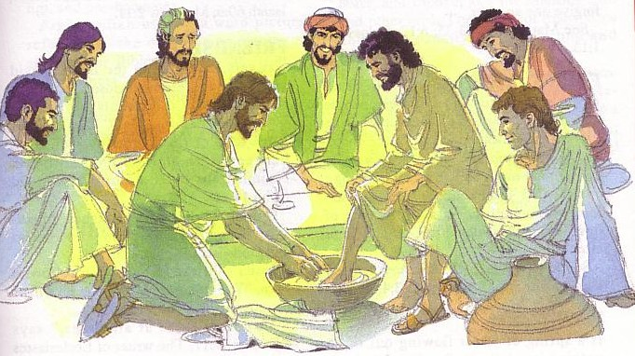
God became man in Jesus
“So the Word became human and lived here on earth among us. He was full of unfailing love and faithfulness. And we have seen his glory, the glory of the only Son of the Father” (John 1:14 NLT)
Notes:
Any doubt as to who is meant by the “Word” is erased once we reached verse 14, which clearly shows the at “Word was God” means that Jews was God.

Slide 14
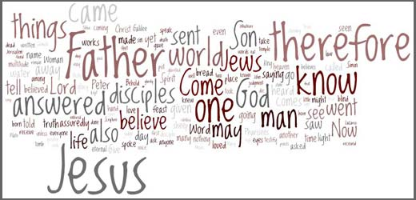
How Does God Speak to Us?
God has spoken in written & oral language

Slide 15
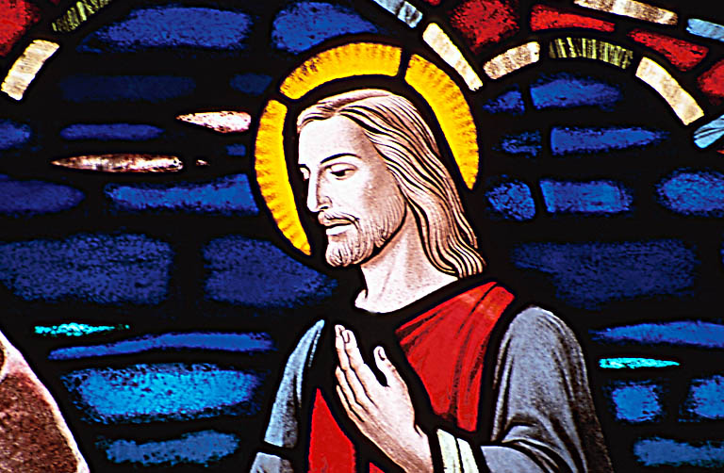
How Does God Speak to Us?
But has especially spoken through a person—Jesus Christ!
Jesus is the logos (word)
This means Jesus fully reveals who God is.
He is the Perfect Revelation.

Slide 16
The Word
GOD

Slide 17
LOGOS
Greek Philosophy:
“Reason”
Philo: “unity with God but distinct; creator, sustainer, & revealer”
OT: “that which lies behind”
Notes:
The background of logos is threefold:
Greek Philosophy: “The term was used technically in the Greek philosophy of this period, particularly by the Stoics, to denote the controlling Reason of the universe, the all-
pervasive Mind which ruled and gave meaning to all things. LOGOS was one of the purest and most general concepts of that ultimate Intelligence, Reason, or Will that is called God” (Merrill C. Tenney, The Gospel of John [Grand Rapids: Eerdmans, 1948; reprint 1975], 62).
OT: “In the LXX Logos is used to translate Heb. dāḇār. The root of this signifies 'that which lies behind', and so when translated as 'word' it, too, means meaningful sound; it may also mean 'thing.'” Some say it is the OT Wisdom literature whereas others say it refers to the Torah.
Philo: Philo was a Jewish philosopher in the first century AD down in Alexandria, Egypt. He combined Jewish and Greek ideas to try to evangelize Greeks to Judaism. The New Bible Dicitonary notes that only Philo's “Logos-teaching provides a clear theological scheme in which the Word possesses a like unity with God and a like distinction from him, and in which both creative and sustaining activity in the universe and revelatory activity towards man is ascribed to it.”

Slide 18
Hebrews 1:1-2 NLT
Long ago God spoke many times and in many ways to our ancestors through the prophets. ²And now in these final days, he has spoken to us through his Son. God promised everything to the Son as an inheritance, and through the Son he created the universe.
Notes:
Long ago God spoke many times and in many ways to our ancestors through the prophets. ² And now in these final days, he has spoken to us through his Son. God promised everything to the Son as an inheritance, and through the Son he created the universe. ³ The Son radiates God's own glory and expresses the very character of God, and he sustains everything by the mighty power of his command. When he had cleansed us from our sins, he sat down in the place of honor at the right hand of the majestic God in heaven. ⁴ This shows that the Son is far greater than the angels, just as the name God gave him is greater than their names.

Slide 19
Exact Beginnings
“In the beginning was the Word” (John 1:1)
“In the beginning God created the heavens and the earth” (Genesis 1:1)
Notes:
This does NOT say that Jesus' existence began with Gen 1:1. “The word 'was' (imperfect tense) implies timelessness. Jesus existed before Gen 1:1. He has a beginning of no beginning” [Jeffrey Khoo, The Story of Jesus, www.febc.edu.sg]

Slide 20
More Parallels
"In Him was life, and the life was the Light of men. ⁵The Light shines in the darkness, and the darkness did not comprehend it" (John 1:4-5)
“Let there be light” (Genesis 1:3)
Notes:
This does NOT say that Jesus' existence began with Gen 1:1. “The word 'was' (imperfect tense) implies timelessness. Jesus existed before Gen 1:1. He has a beginning of no beginning” [Jeffrey Khoo, The Story of Jesus, www.febc.edu.sg]

Slide 21
Jesus (logos) has always been in fellowship with the Father (1:1b)
“In the beginning
was the Word,
and the Word was with God,
and the Word was God”
(John 1:1 NIV)
Notes:
Scripture is very clear that Jesus is God. Christians have always believed this key doctrine called the deity of Christ.

Slide 22
The Father, Son & Spirit

Slide 23
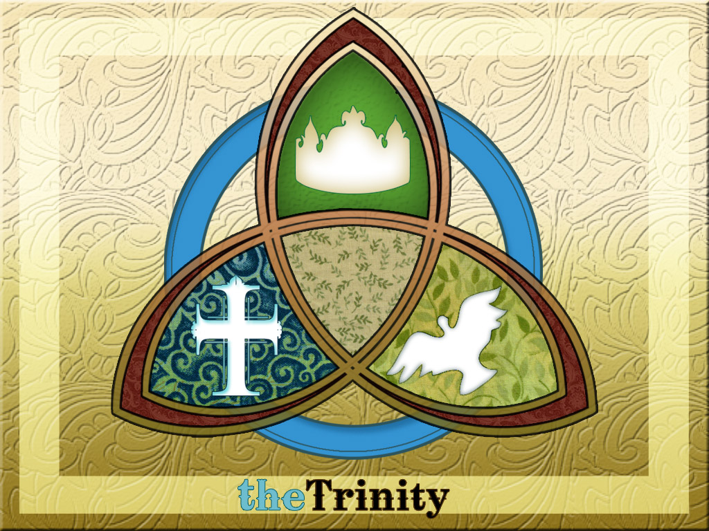
The Trinity
The distinction has to do with personality. The logos is a person by Himself.
He is “with” God in the sense that He is “in the presence” or “in the company” of God.
The logos is distinguished from God.
The distinction has nothing to do with the essence, for Jesus is the same essence with God.
Jeffrey Khoo, The Story of Jesus (www.febc.edu.sg)

Slide 24
But how can… the “Son of God” = God Himself?
Jesus claimed to be the Son of God at his trial (Luke 22)
Thus "Son of God" is higher than "Christ” and a claim to be God
The Jewish leaders accused Him of blasphemy
They did NOT accuse him of blasphemy when he claimed to be the Son of Man, or Messiah (Christ)

Slide 25
Jesus is God (1:1c)
“In the beginning
was the Word,
and the Word was with God,
and the Word was God”
(John 1:1 NIV)
Notes:
Scripture is very clear that Jesus is God. Christians have always believed this key doctrine called the deity of Christ.

Slide 26
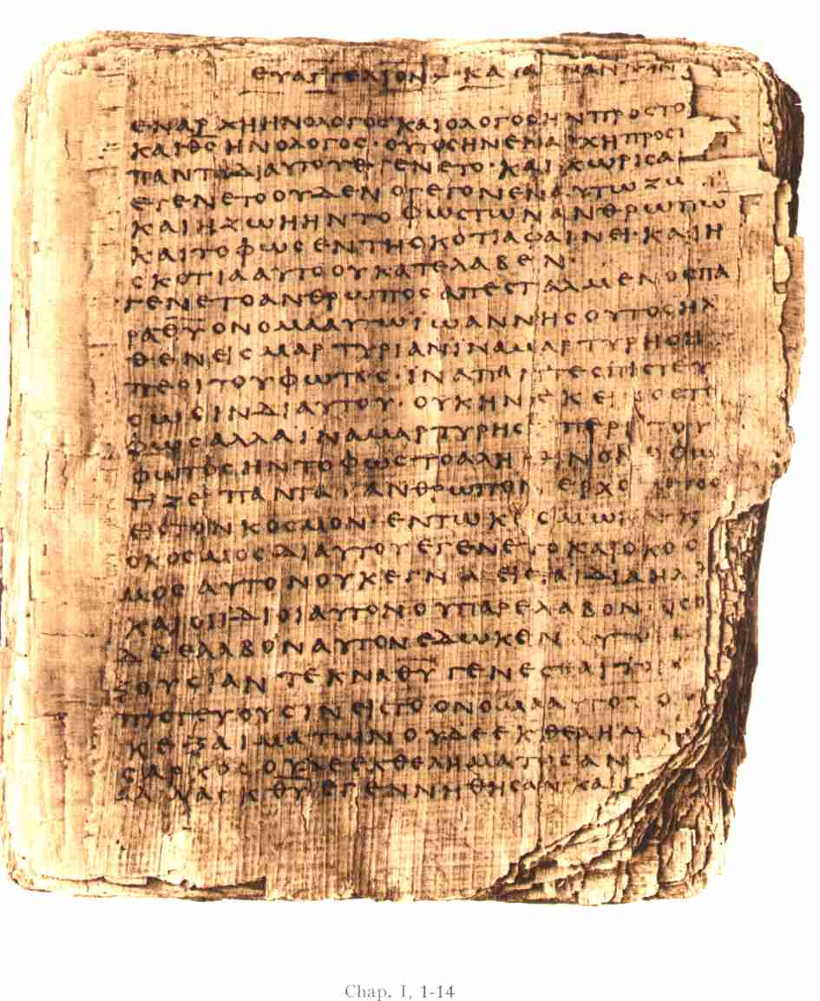
“The Word was God” (1:1c)
The Jehovah Witness New World Translation translates this “The Word was a god”
Any problems with this? Plenty!
Bad Greek grammar
Teaches more than one god
Makes Jesus a lesser god
No other translation mistranslates it like JWs do

Slide 27
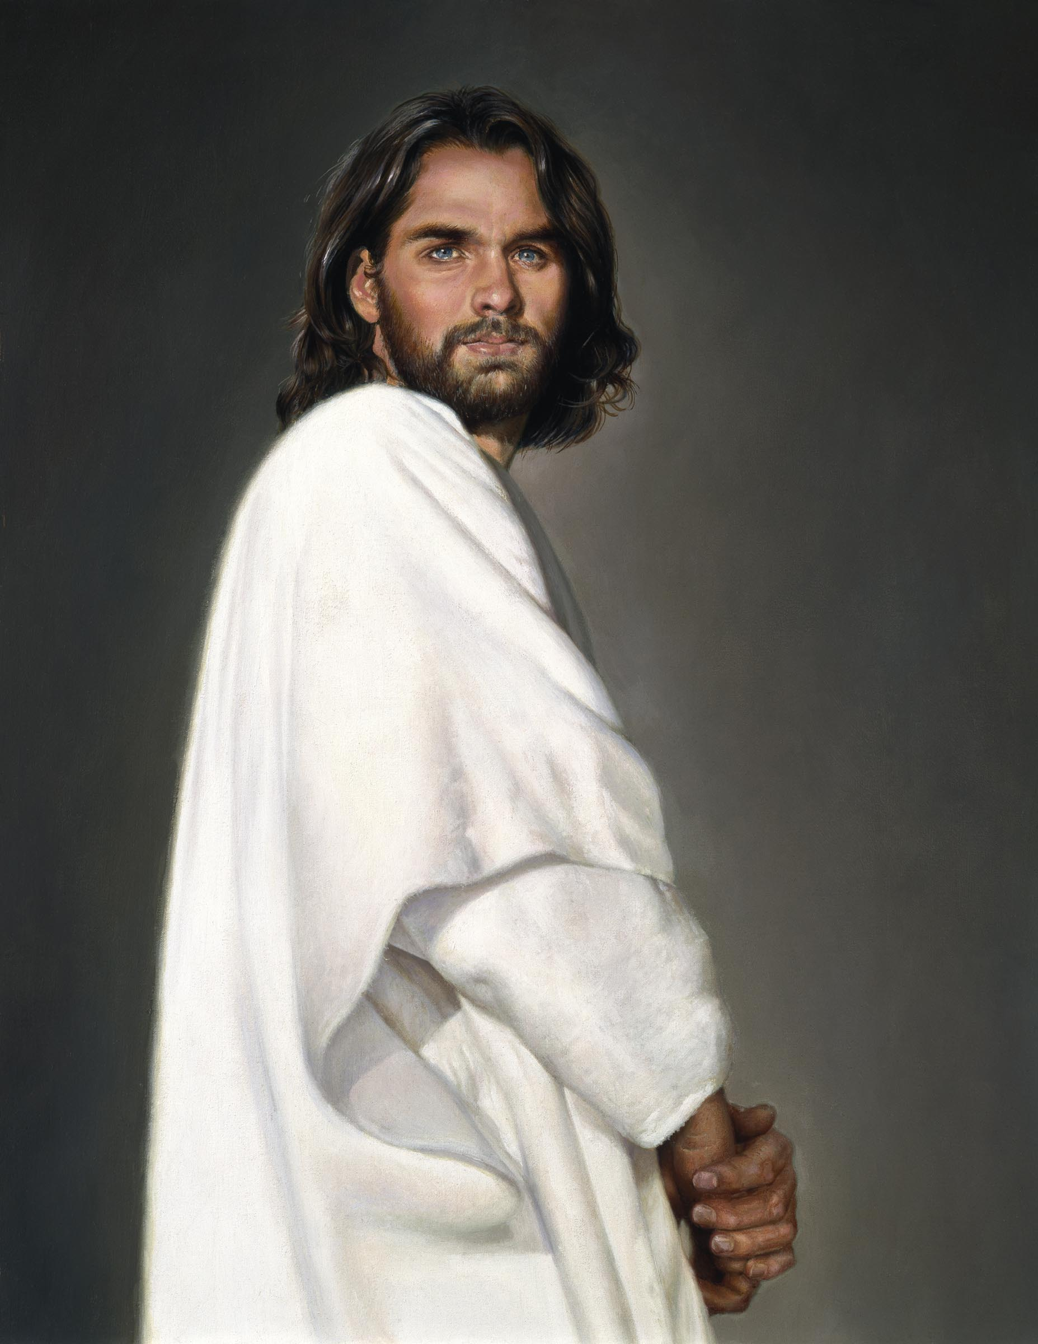
Who is Jesus Christ… really?
Brown:
Bible:
Only human
God-Man
Notes:
Now let's turn our attention away from historical inaccuracies about the canon to the early view of Jesus himself.

Slide 28
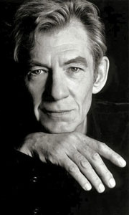
Brown's view of Jesus through “historian” Leigh Teabing…
"My dear," Teabing declared, "until [AD 325], Jesus was viewed by His followers as a mortal prophet... a great and powerful man, but a man nonetheless. A mortal." [Sophie:] "Not the Son of God?" "Right," Teabing said. "Jesus' establishment as 'the Son of God' was officially proposed and voted on by the Council of Nicaea."
Da Vinci Code, 197

Slide 29
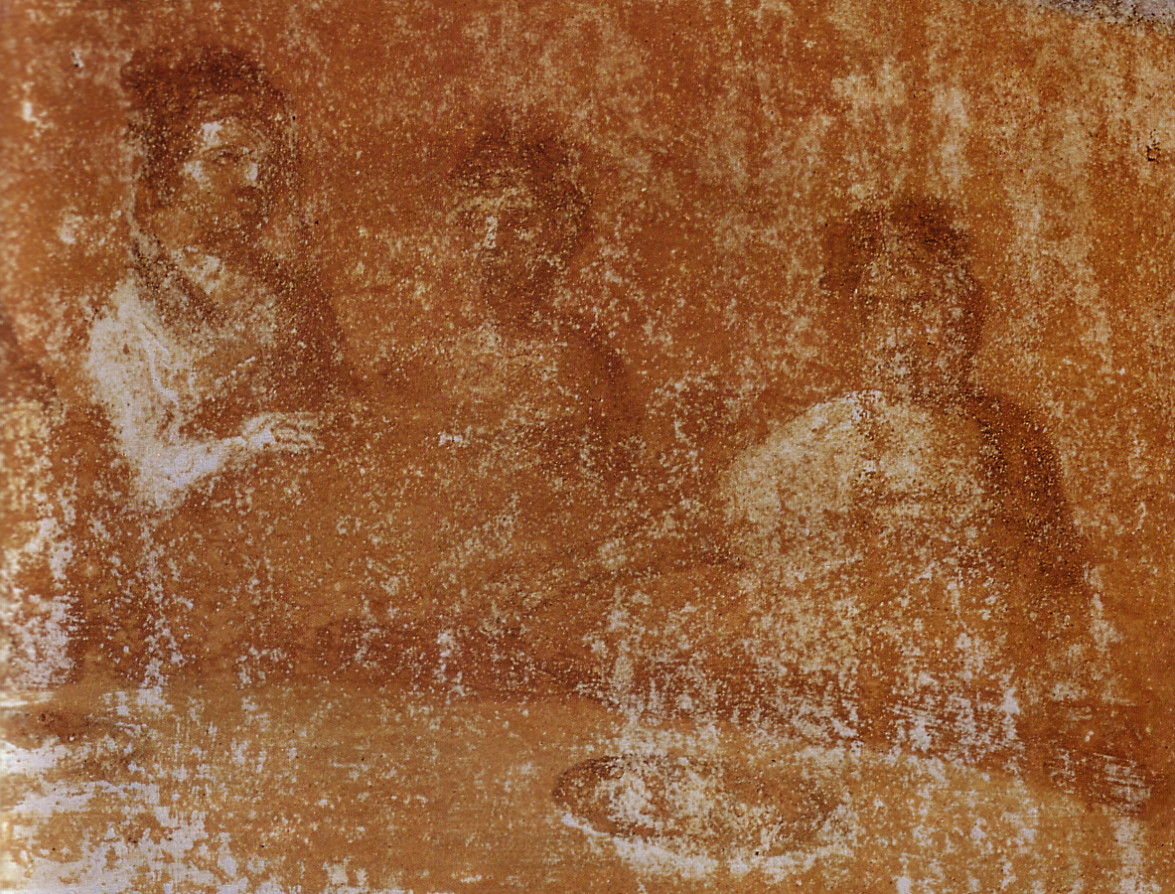
So what did the early Church really believe about Jesus?
Notes:
Here is where Brown rewrites not only the history of what unbelievers thought--he rewrites Christians' view of Jesus.

Slide 30
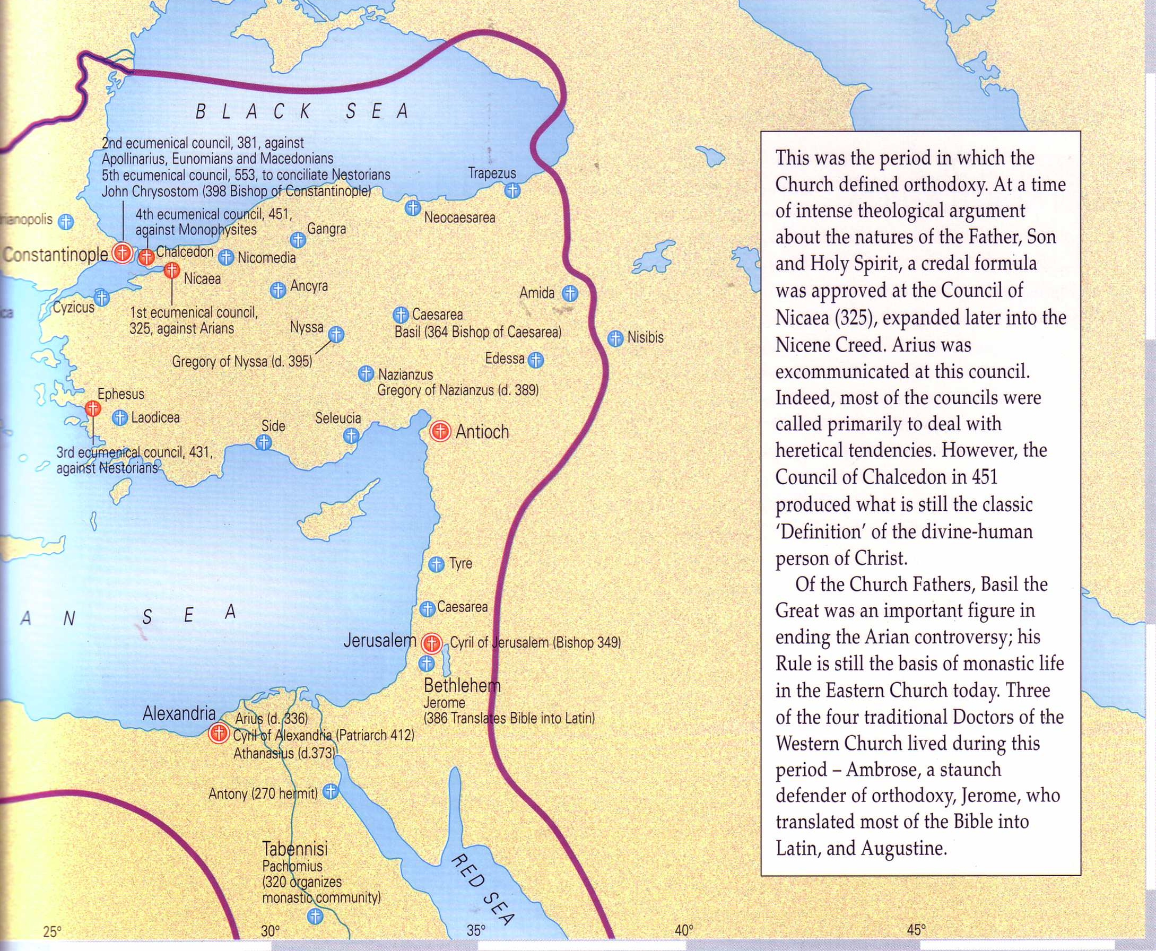
What About Nicaea (AD 325)?
Bishops throughout the Eastern Empire gathered & excommunicated Arius of Alexandria
The Atlas of the Bible and the History of Christianity, ed. Tim Dowley (London: Three's Company, 1997), 77
Notes:
Now let's see what one of the earliest councils thought of Jesus. The focal point in Nicaea (modern Turkey) was on the contrary beliefs of two church leaders in Alexandria, Egypt.

Slide 31
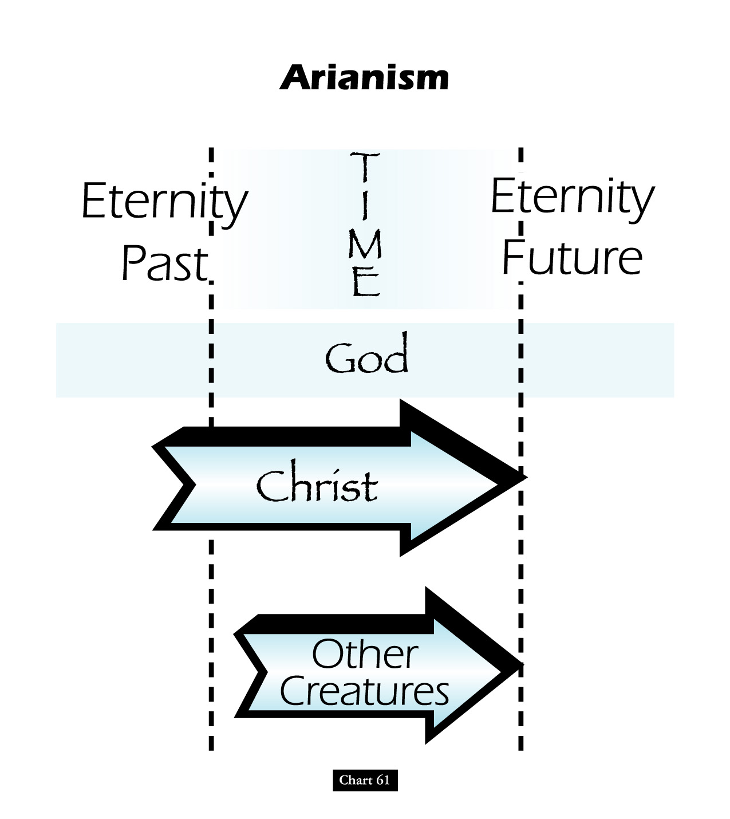
Teachings of the Heretic Arius
John D. Hannah, Charts of Ancient & Medieval Church History (Grand Rapids: Zondervan, 2001)
Notes:
One of these leaders was named Arius. He denied that Christ was “co-eternal” with the Father. Arius taught that Christ had a beginning point in eternity past.

Slide 32
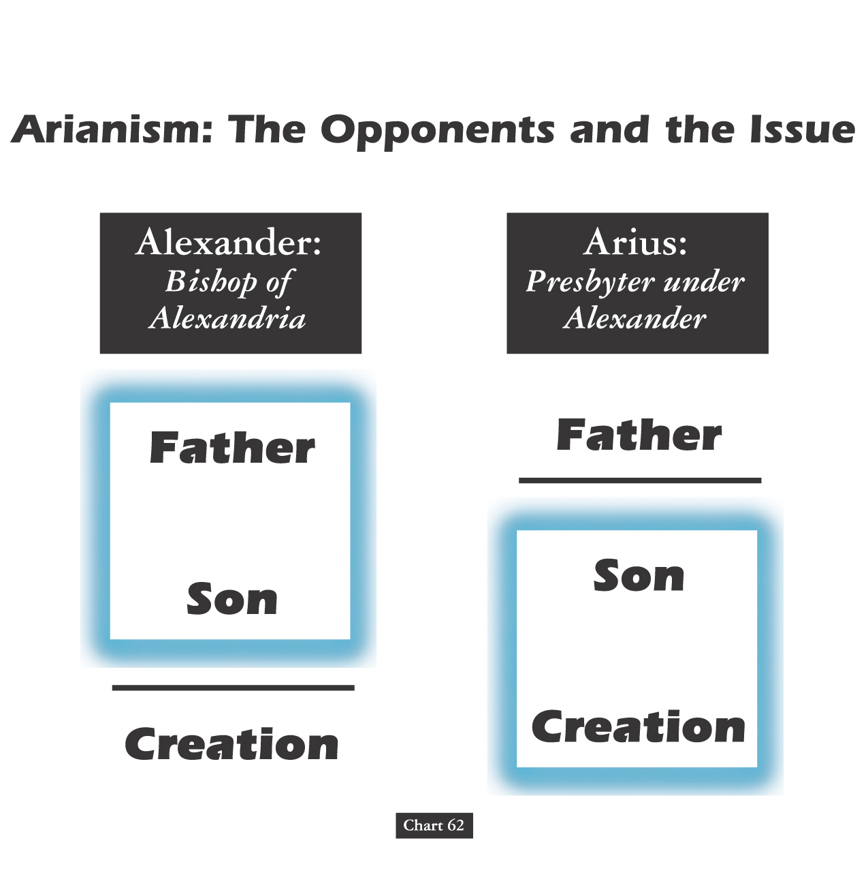
Arianism: Opponents and the Issue
John D. Hannah, Charts of Ancient & Medieval Church History (Grand Rapids: Zondervan, 2001)
Notes:
Alexander was the “boss” of Arius who held to the orthodox view that the Father and Son stood apart from creation. However, Arius believed only the Father to be separate from creation. Arius taught that the Father created Jesus, then Jesus created the world after this.

Slide 33
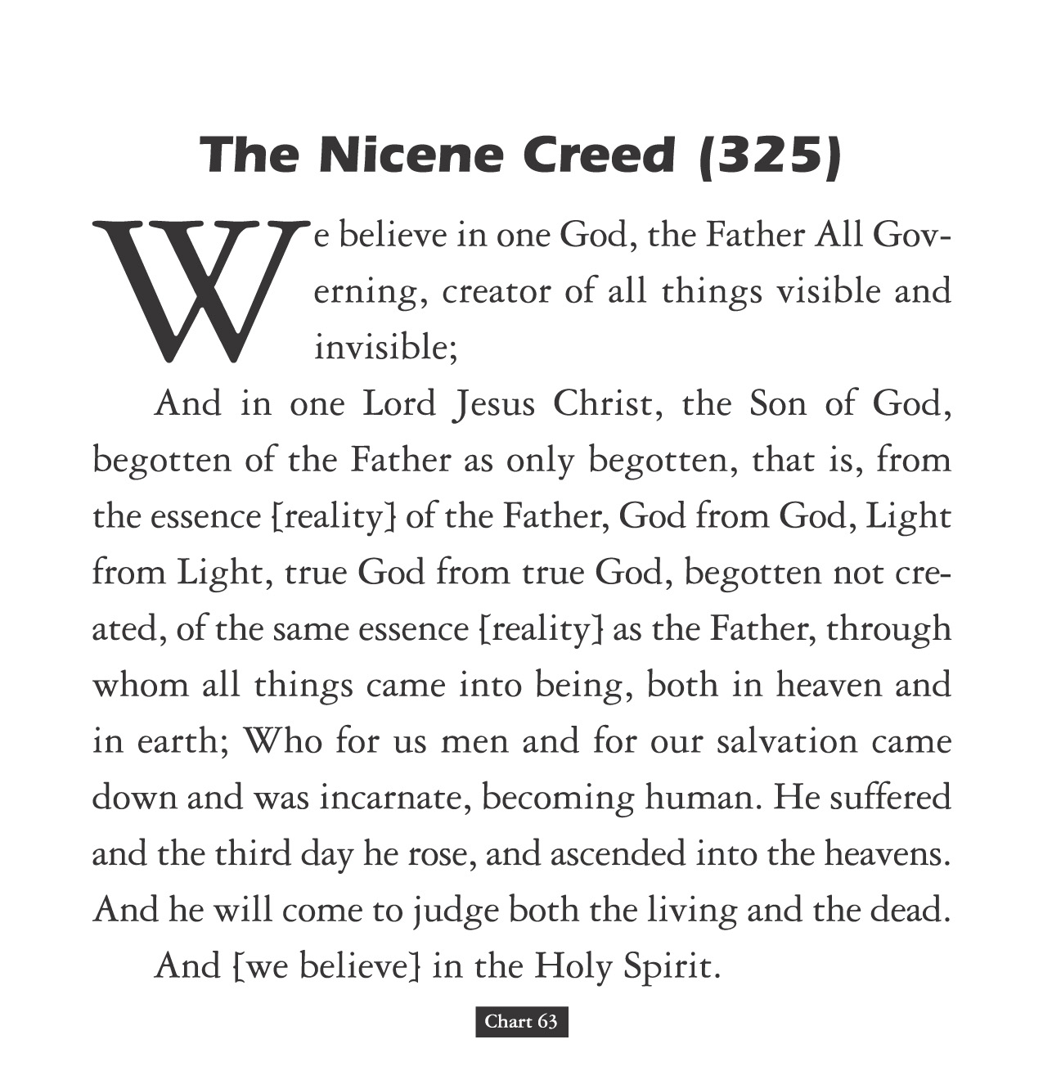
The Nicene Creed (AD 325)
John D. Hannah, Charts of Ancient & Medieval Church History (Grand Rapids: Zondervan, 2001)
Notes:
The orthodox view won out and was expressed in the Nicene Creed.

Slide 34
What About Nicaea?
300 votes
Fiction
Fact
2 votes
Arians:
“Jesus Not God”
Orthodox:
“Jesus is God”
Arians:
“Jesus Not God”
Orthodox:
“Jesus is God”
AD 325
Council of Nicaea
Notes:
Brown claims (without support) that the Nicaea vote on whether Jesus was co-eternal with God was very close. The truth is that the vote of the 302 leaders present was 300 to 2. “The two dissenting bishops were Secundus of Ptolemais and Theonas of Mamarica, both Libyan bishops associated with Arius. All three went into exile after the Council of Nicea” (Paul L. Maier in The Da Vinci Code: Fact or Fiction? with Hank Hanegraaff [Wheaton: Tyndale, 2004], 15, n. 6, on p. 73).

Slide 35
1st century belief in Deity
Paul: “Christ, who is God over all” Rom. 9:5
Peter: “God and Savior Jesus Christ” 2 Pet. 1:1
The Father: “About the Son He says, 'Your throne, O God…'” Heb. 1:8
Jesus: “I and the Father are one” John 10:30
Notes:
There is NO doubt that the earliest Christians believed that Jesus was God! Hebrews 1:8 gives us the witness of the Father himself, and where can one find a more reliable witness than God himself?

Slide 36
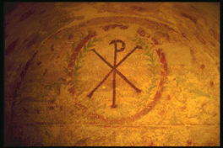
Belief in Christ's Deity Before Nicaea
Ignatius: “God Himself was manifest in human form” (AD 105) Clement: “It is fitting that you should think of Jesus Christ as of God” (AD 150) Irenaeus: “He is God, for the name Emmanuel indicates this” (AD 180) Tertullian: “… Christ our God” (AD 200) Origen: “No one should be offended that the Savior is also God” (AD 225) Lactantius: “We believe Him to be God” (AD 304)
Bercot, 93-100 in Garlow & Jones, 94
Notes:
Over and over the early church fathers affirmed that Jesus was God--all long BEFORE Nicaea!

Slide 37
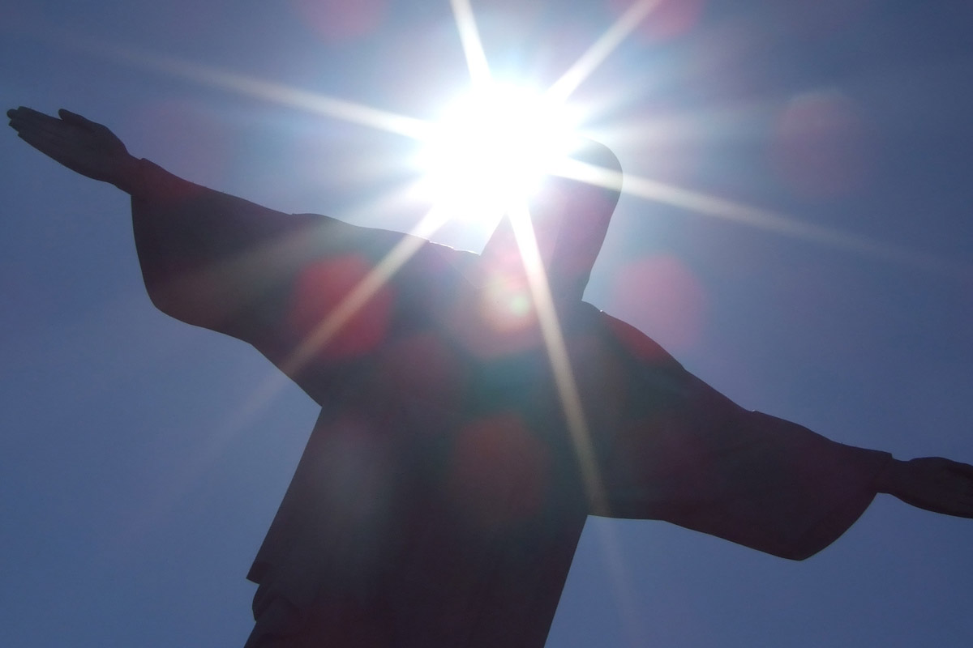
Jesus as Revealer
“The one who reveals God fully, not fragmentarily, must be no less than God.”
Everett F. Harrison, John: The Gospel of Faith, 14-16

Slide 38
Black

Slide 39
II. Jesus created all things (1:3).
“God created everything through him, and nothing was created except through him” (1:3 NLT)

Slide 40
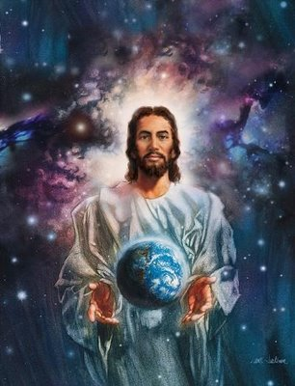
Jesus is the source of all things existing today

Slide 41
“American Jesus”

Slide 42
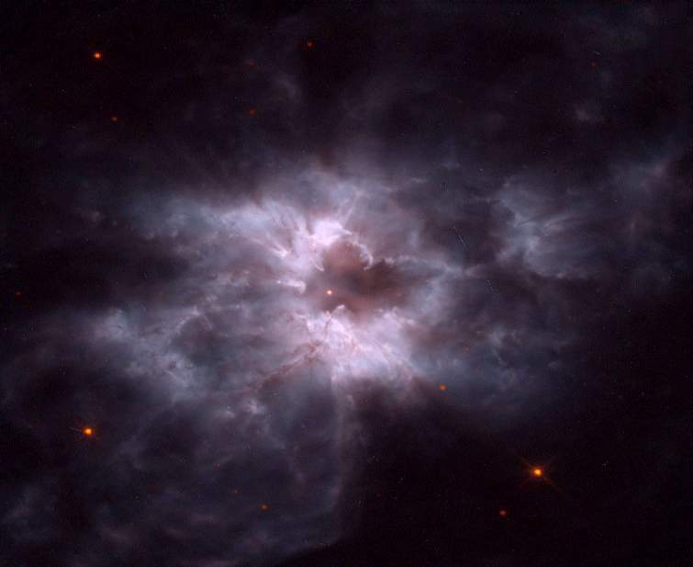
Light
God's Creation…Day 1
Then God said, “Let there be light”; and there was light. God saw that the light was good, and he separated the light from the darkness (Gen. 1:4).

Slide 43
Light
God's Creation…Day 1
Then Jesus said, “Let there be light”; and there was light. Jesus saw that the light was good, and he separated the light from the darkness (Gen. 1:3-4).

Slide 44
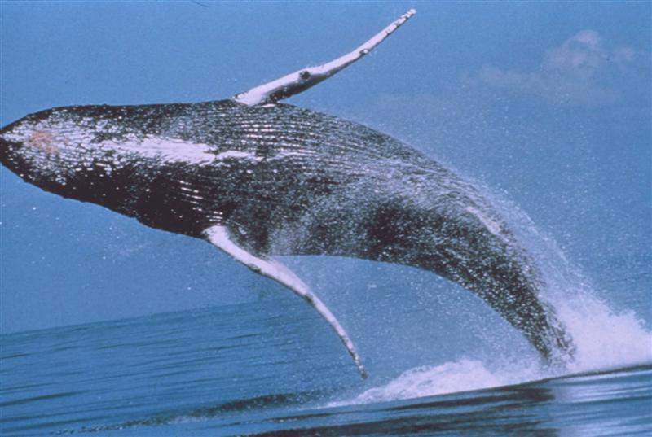
Whales
God's Creation…Day 5
God created the great sea monsters and every living creature that moves, with which the waters swarmed after their kind (Gen. 1:21a)…

Slide 45
Whales
God's Creation…Day 5
Jesus created the great sea monsters and every living creature that moves, with which the waters swarmed after their kind (Gen. 1:21a)…

Slide 46
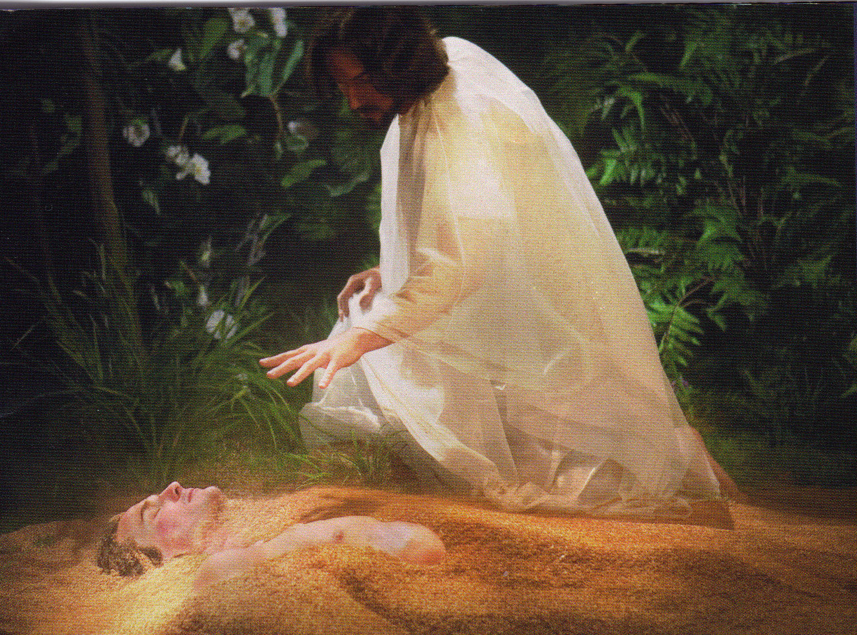
Jesus formed Adam from the dust (John 1:3; Gen. 2:7).

Slide 47
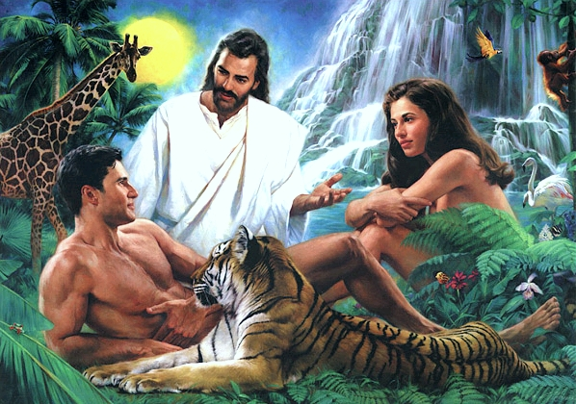
Jesus Created Adam and Eve (John 1:3; Gen. 2:21-23)

Slide 48
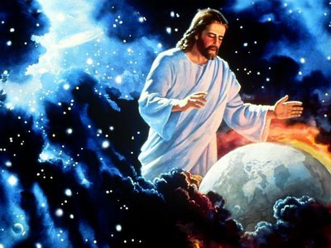
Jesus also sustains his creation

Slide 49
Christ in Colossians
“Christ is the visible image of the invisible God. He existed before anything was created and is supreme over all creation” (Col. 1:15).

Slide 50
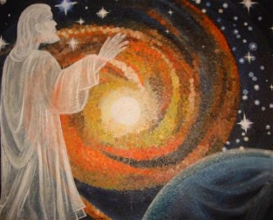
Col. 1:16-17
“for through him God created everything in the heavenly realms and on earth.
He made the things we can see
and the things we can't see—
such as thrones, kingdoms, rulers, and authorities in the unseen world.
Everything was created through him and for him.
¹⁷He existed before anything else, and he holds all creation together” (Col. 1:16-17 NLT).

Slide 51
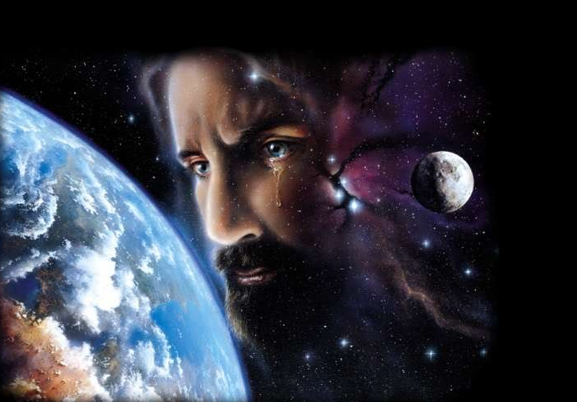
Jesus weeps over His creation
“He came into the very world he created, but the world didn't recognize him. ¹¹He came to his own people, and even they rejected him” (John 1:10-11 NLT)

Slide 52
What is the life and light (4-5)?
“The Word gave life to everything that was created, and his life brought light to everyone.
⁵The light shines in the darkness,
and the darkness can never extinguish it” (1:4-5 NLT)

Slide 53
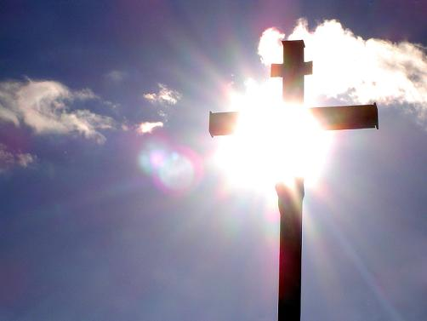
III. Jesus gives eternal life and deliverance from spiritual darkness (1:4-5).
“In him was life, and that life was the light of all men.
⁵ The light shines in the darkness, but the darkness has not understood it” (1:4-5 NIV)

Slide 54
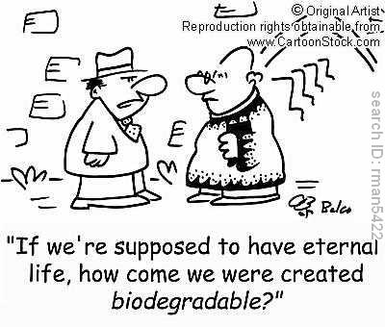
What Kind of Eternal Life?

Slide 55
Jesus gives eternal life
“In him was life, and that life was the light of all men.
⁵ The light shines in the darkness, but the darkness has not understood it” (1:4-5 NIV)

Slide 56
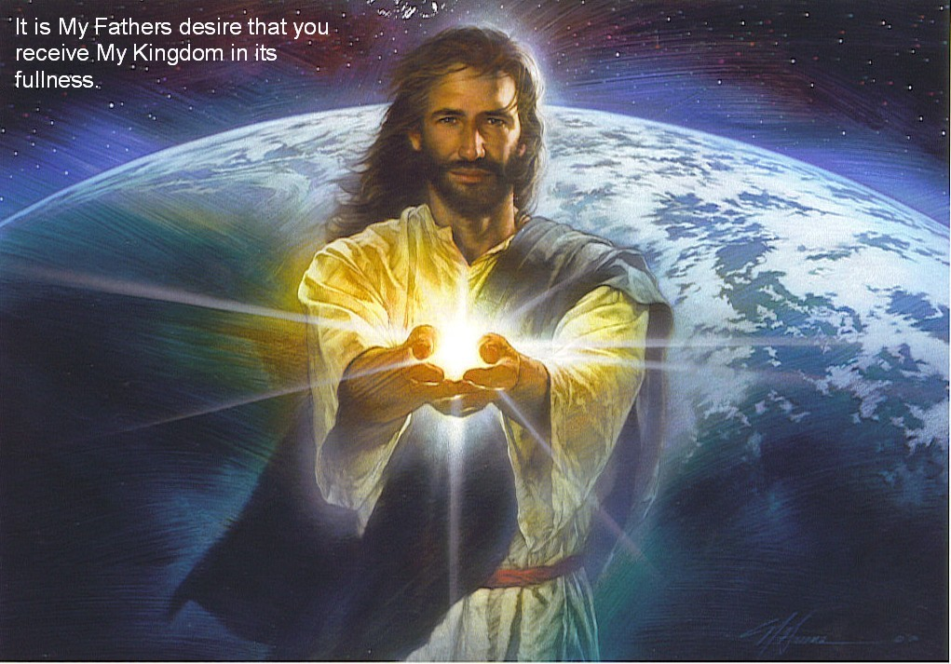
Jesus gives spiritual light
“In him was life, and that life was the light of all men.
⁵ The light shines in the darkness, but the darkness has not understood it” (1:4-5 NIV)

Slide 57
Black

Slide 58
The Gospel of John

Slide 59
Summarizing Jesus as God in John 1:1-5
In a few compact sentences the Word is seen in relation to God (1-2), to the creation (3), and to men (4-5).
Everett F. Harrison, John: The Gospel of Faith,14-16
Jesus existed before creation (1-2).
Jesus created all things (3).
Jesus gives eternal life and deliverance from spiritual darkness (4-5).

Slide 60
Trust Jesus for salvation because He is truly God!
Main Idea of John 1:1-5

Slide 61
Jesus makes us children of God
“But to all who believed him and accepted him, he gave the right to become children of God” (1:12 NLT)

Slide 62
Black

Slide 63
NT Preaching link at BibleStudyDownloads.org
Get this presentation and script for free!
Notes:
NT Preaching (np)

